Slide 1
Content Security Policy
Omni knowledge share meeting 19.06.2024

Slide 2
Let’s start with a demo!
https://gallery.oto-jest-wawrzyn.pl/

Slide 3
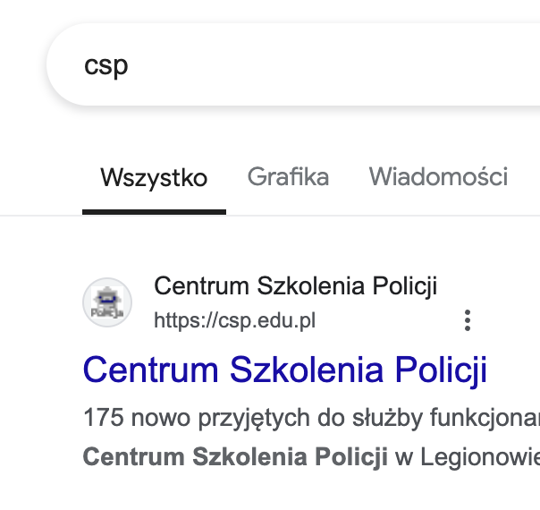
What’s this CSP?
Content Security Policy is a security mechanism that allows to filter the way a website requests resources, e.g.:
Block all WebSocket traffic.
Disallow “eval” and function constructor.
Allow loading images only from imgur.com and img.bb.
Allow loading media only on HTTPS.
Disallow running the page from an iframe.

Slide 4
How it protects the user?
A malicious party may use native browser communication mechanisms to launch an attack.
As a website creator, we know how the website will be used - so we can restrict the browser behaviour to only our-defined ones.
By default - all is blocked.

Slide 5
Example CSP
default-src 'self'; img-src imgur.com; media-src example.org example.net; script-src userscripts.example.com
Directives separated by semicolons.
Special values:
`self` - an alias to the same domain.
`none` - no resource will be loaded.
* - allow all.

Slide 6
On script-src directive
`unsafe-inline` - allows for JS inside script element and inline event handlers (onchange=”function()”).
`unsafe-eval` - allows for `eval`, Function constructor etc.
`nonce-<value>` - allows for only executing the script that has nonce=<value> attribute. (Injected by server, per each request.)
`<hash>` - allows execution of script that hashes to a given value.

Slide 7
Ways of adding CSP to our website
As a response header:
Content-Security-Policy: default-src 'self'; img-src cdn.example.com;
All features are supported here.
In HTML:
<meta http-equiv="Content-Security-Policy" content="img-src imgur.com">
Useful when we cannot control the headers.
Almost everything is supported this way.

Slide 8
Implementing the usage of CSP
Enabling the CSP on a ready page will most surely result in broken website - we cannot foresee everything, so CSP may block stuff that was expected to work.
Content-Security-Policy-Report-Only - doesn’t block, but logs the violation and (optionally) sends the violation report to given endpoint.

Slide 9
Do we need CSP at Omni?
Note that presented attack relies on user input. If there’s no such mechanism, there may be no great value in implementing CSP.
When the page content is curated we already have an additional protection.
Remember that CSP is only one layer of possible actions - it shouldn’t be used by itself.

Slide 10


And we’re done
Without CSP:
With CSP:
As always, thank you! Any questions?

